Slide 1

Introduction to Machine Learning
Notes:
1

Slide 2
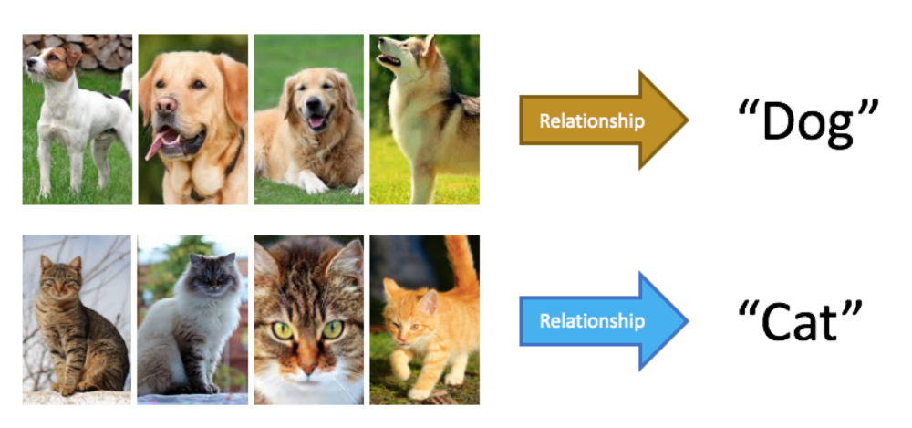
Introduction to Machine Learning
Learning process
Notes:
2

Slide 3
Introduction to Machine Learning
Learning or Training?
Notes:
3

Slide 4
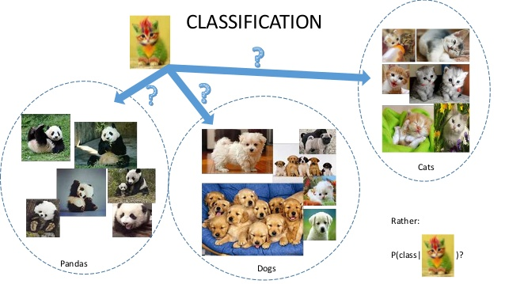
Introduction to Machine Learning
Let’s Test Your Learning
Notes:
4

Slide 5
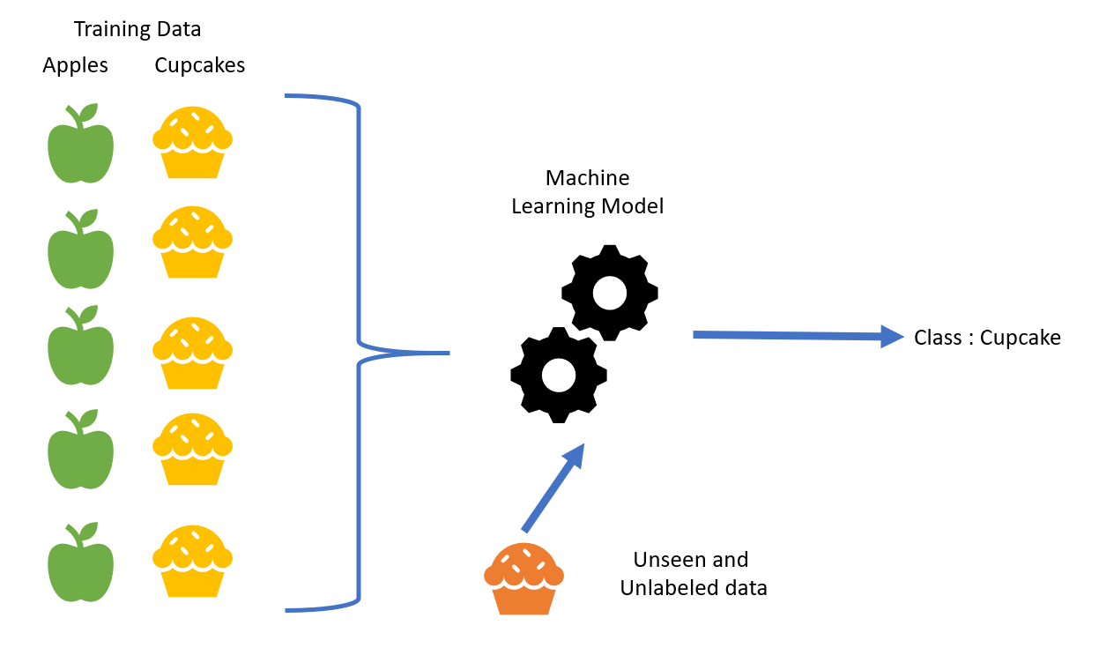
Introduction to Machine Learning
Supervised Learning
Notes:
5

Slide 6

Introduction to Machine Learning
Think About It:
Learning to categorize different objects is the only kind of learning?
What if you have access to objects but no body is supervising you about their classes/categories/labels?
What is the best that you can do in the absence of a supervisor?
Notes:
6

Slide 7
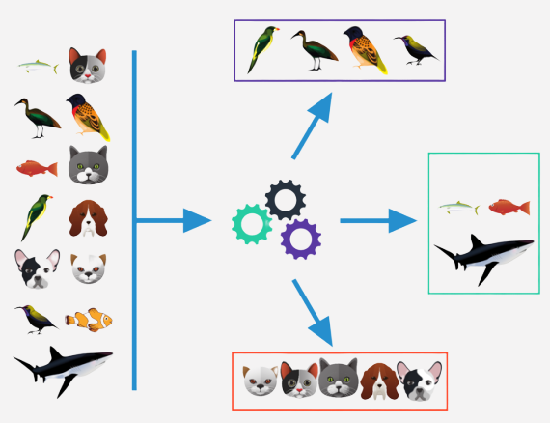
Introduction to Machine Learning
Unsupervised Learning
No labels
Notes:
7

Slide 8
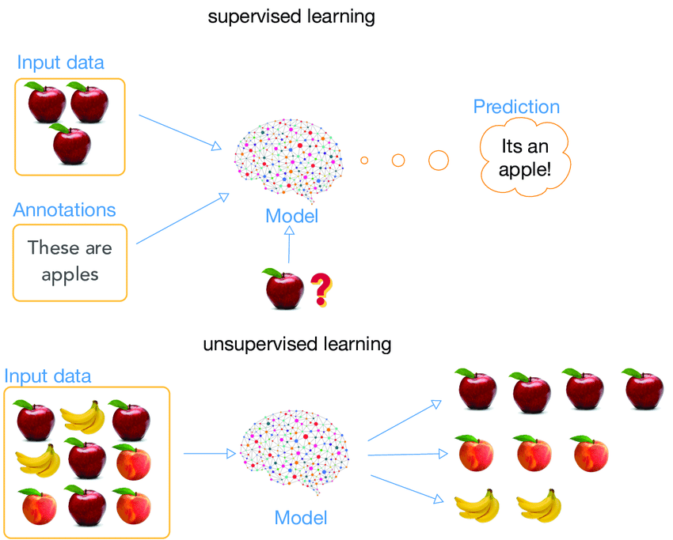
Introduction to Machine Learning
So Far…
Notes:
8

Slide 9
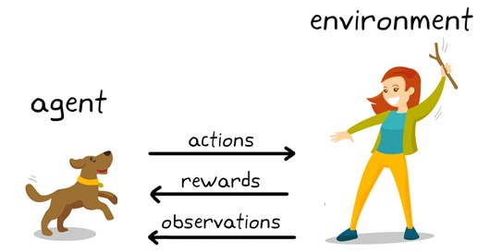
Introduction to Machine Learning
Reinforcement Learning
Notes:
9

Slide 10
Introduction to Machine Learning
It seems like easy to learn to categorize or to group different objects. We do it every time!
Why this is harder for machines?
Notes:
10

Slide 11
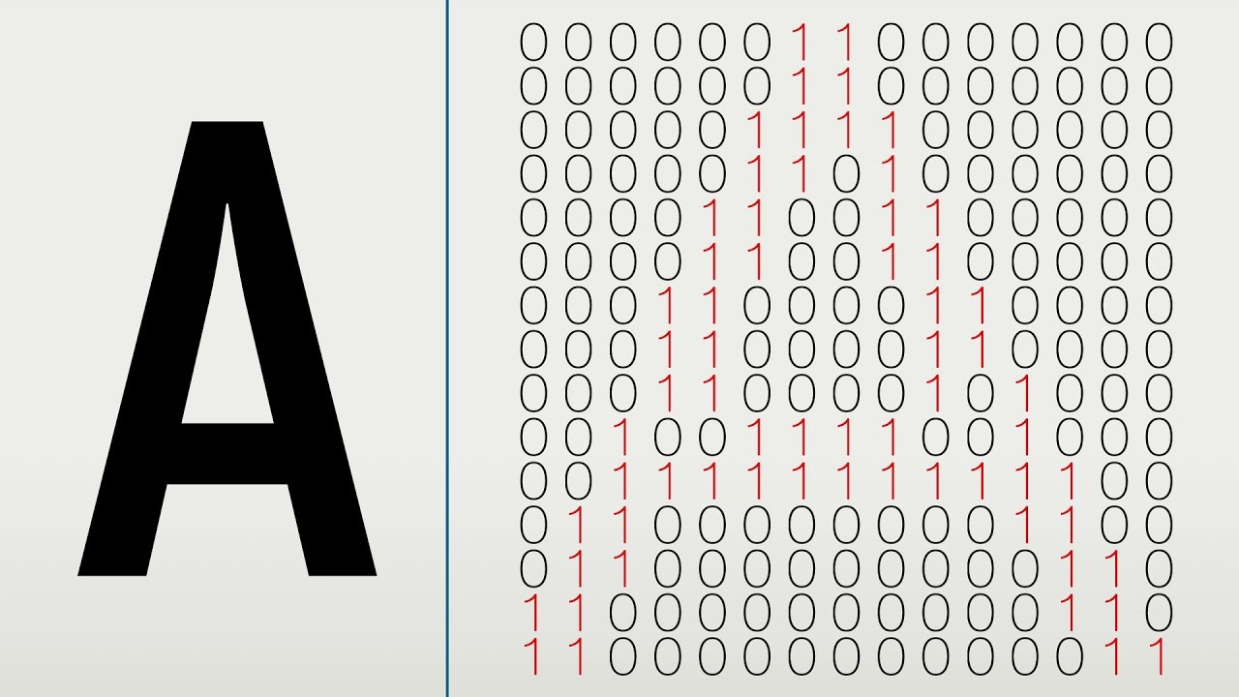
Introduction to Machine Learning
Why this is harder for machines?
Brain?
Notes:
11

Slide 12
Introduction to Machine Learning
Importance and future of machine learning
History of machine learning
Arthur Samuel of IBM developed a computer program for playing checkers in the 1950s. Arthur Samuel first came up with the phrase “Machine Learning” in 1952.
In 1957, Frank Rosenblatt – at the Cornell Aeronautical Laboratory – combined Donald Hebb’s model of brain cell interaction with Arthur Samuel’s Machine Learning efforts and created the perceptron.
Most widely used branch of computer science nowadays(google)
Notes:
12

Slide 13

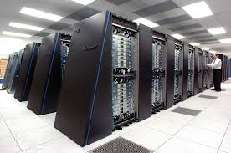
Introduction to Machine Learning
Why this is an era of machine learning
Powerful machines that can handle computations quickly
Availability of huge amount of data
Advancement of technology and knowledge among people
Notes:
13

Slide 14
Introduction to Machine Learning
Terminologies
Training data
Testing data
Validation data
Outliers
Model
Training a model
Over fitting
Under fitting
Parameters
Hyper Parameters
Labels
Features
Dimensions
Probability distribution
Curse of dimensionality
Accuracy
Error, Loss, Risk
Optimization
Generalization
Validation and cross validation
Data Snooping
SSS problems
One shot learning
Notes:
14

Slide 15
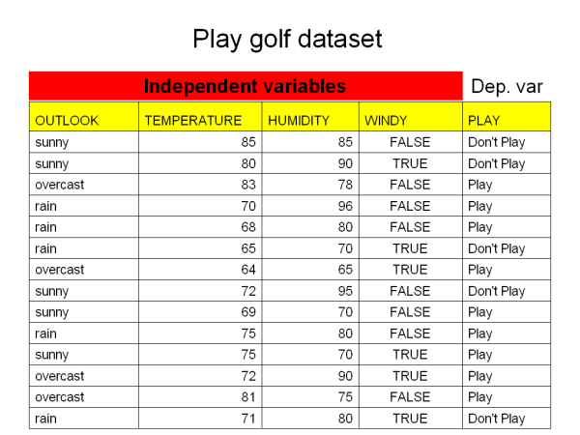
Introduction to Machine Learning
Dataset
A data set (or dataset) is a collection of data.
Dataset is a table, where every column of a dataset represents values of a particular variable, and each row corresponds to a given record of the dataset.
Each value in the dataset is regarded as a datapoint
The last column of data usually contains labels
Notes:
15

Slide 16
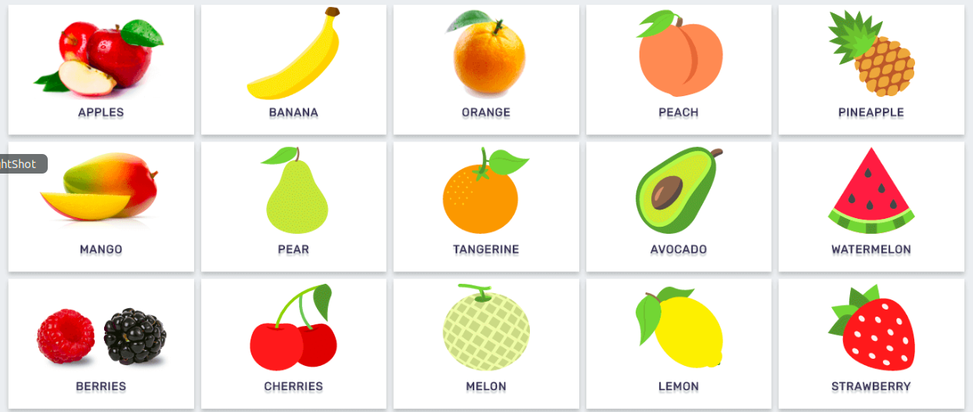
Introduction to Machine Learning
Label
A label or target is referred as the output of the data.
A labelled dataset contains label which can be any output to classify the data such as cats or dogs, 0s or 1s.
When a model is trained it predicts the labels of the data given to it also known as classes
In machine learning, if labels are not in numeric form, then we convert them into numeric form
For example Apple=0, Pear=1, etc
Notes:
16

Slide 17
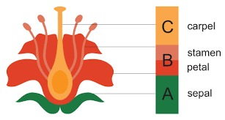
Introduction to Machine Learning
Features
A feature is an individual measurable property or characteristic of a phenomenon being observed.
Previously we used the term data points, in machine learning data points are formed by features.
A feature is a finite number which is observed by the observer
There are a lot of feature extraction techniques available
Performance of Model depends a lot on the features that we have selected
Notes:
17

Slide 18
Introduction to Machine Learning
Splitting the data
Training data
Testing data
Validation data
Notes:
18

Slide 19
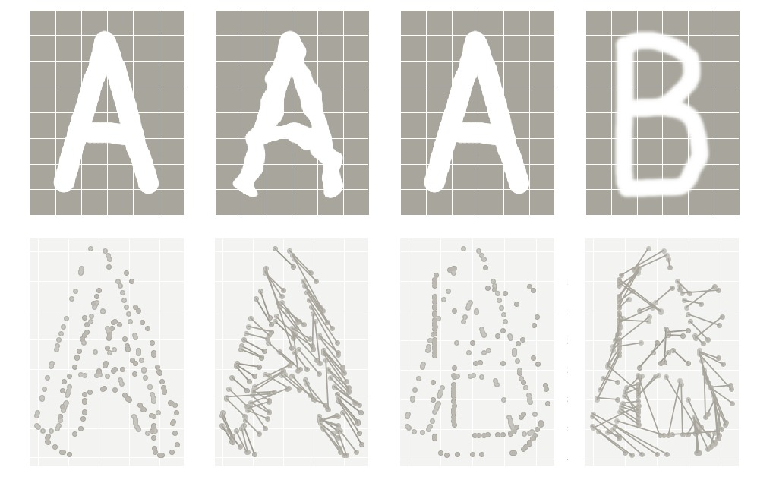
Introduction to Machine Learning
Training data
A machine learns from data. It finds relationships, and patterns from data.
The data provided to the machine to learn and train itself is called training data.
Notes:
19

Slide 20
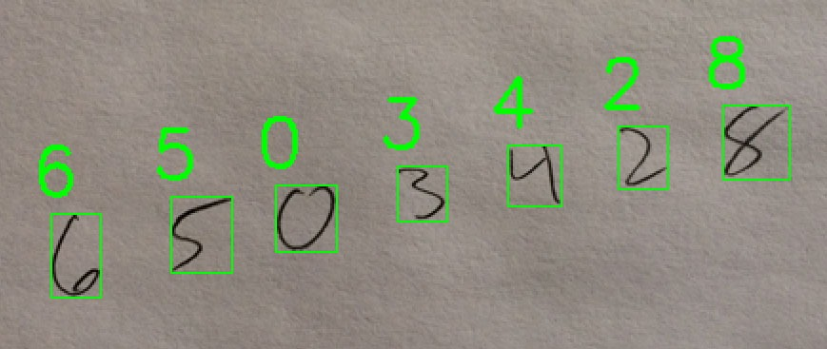
Introduction to Machine Learning
Testing data
Once the machine is trained by using training data, in order to test the machine if it is working fine or not, we use another set of data which should not be the same data on which the model was trained,known as testing data
Notes:
20

Slide 21
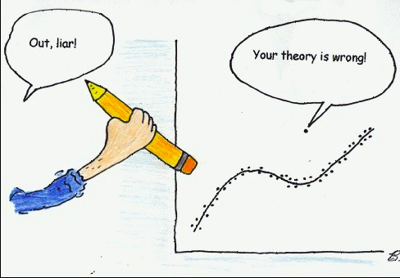
Introduction to Machine Learning
Outliers
In the dataset there might be some data points that differ from all other data points
Outliers are normally excluded from the dataset.
They can be identified by visualizing the dataset
Notes:
21

Slide 22
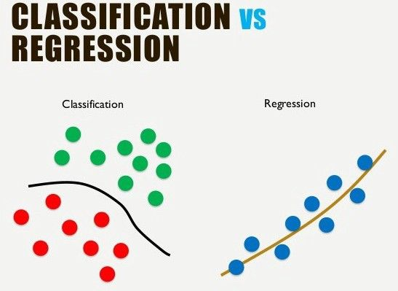
Introduction to Machine Learning
Model
A machine learning model is a mathematical equation or expression that tries to fit the data and learn to predict the unseen data
Samples are encoded as being vectors with real values
After encoding, every sample is really a point in some feature space
Model is a function in the feature space
Dimensions
Parameters
Hyperparameters
Notes:
22

Slide 23
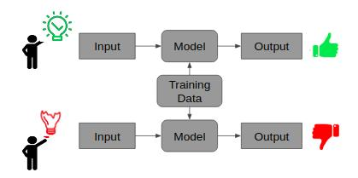
Introduction to Machine Learning
Training a model
The process of trying to fit the training data into a model through a machine learning algorithm to achieve a pattern in the data for predicting an unseen data is known as training a model
Finding the parameters of the model that best capture the pattern of the data
Notes:
23

Slide 24
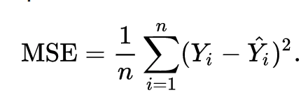
Introduction to Machine Learning
Cost, Error, Loss, Risk, Accuracy
Notes:
24

Slide 25
Introduction to Machine Learning
Optimization
Notes:
25

Slide 26
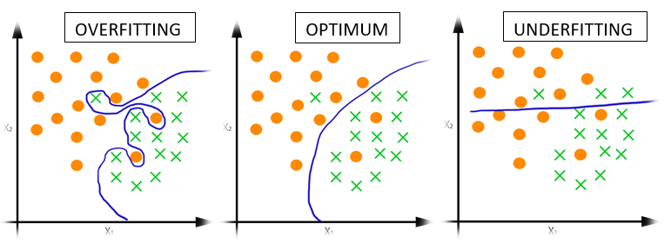
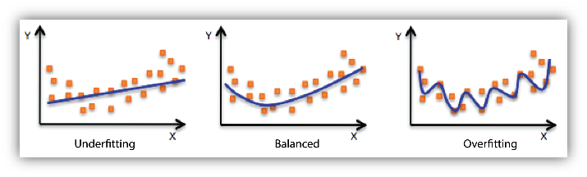
Introduction to Machine Learning
Overfitting, Underfitting, Just Right/Optimum
Notes:
26

Slide 27
Introduction to Machine Learning
Validation and Cross Validation
Notes:
27

Slide 28
Introduction to Machine Learning
Generalization, Data Snooping, Validation Set
Notes:
28

Slide 29
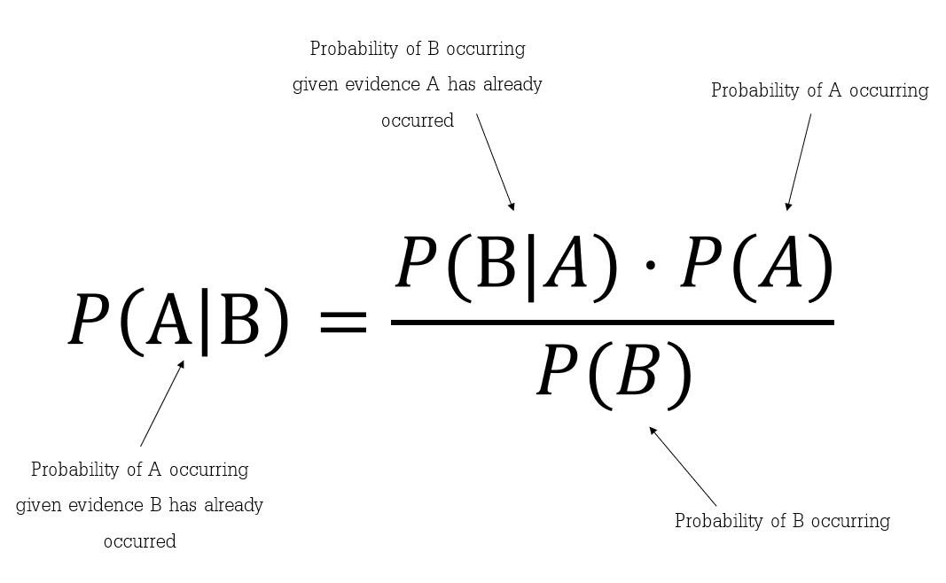
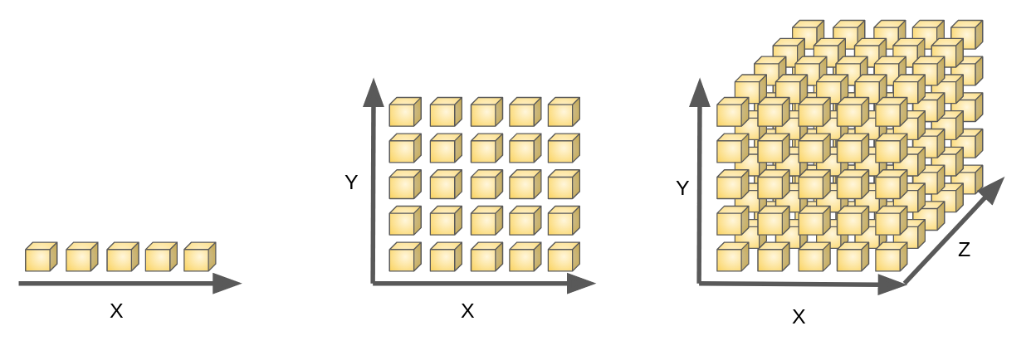
Introduction to Machine Learning
Probability Distributions and Curse of Dimensionality
Notes:
29

Slide 30
Introduction to Machine Learning
Small Sample Size problems
One Shot Learning
Notes:
30

Slide 31
Introduction to Machine Learning
Importance of data in machine learning
Formats of data
Structured data
Labeled data
Unlabeled data
Unstructured data
How to choose the best format of data
Notes:
31

Slide 32
Introduction to Machine Learning
Data Encoding and Preprocessing
Images
Videos
Audio
Text
One Hot encoding
Data standardization
Notes:
32

Slide 33
Introduction to Machine Learning
A general flow of a typical Machine learning project
Data collection
Feature extraction
Data preprocessing
Model training
Testing
Validation
Repeat/Happy Ending
Notes:
33

Slide 34
Let’s get started with SVM
Notes:
34

